Slide 1
Students Monitoring & Supervising Application
Monitorial

Slide 2
Project Supervisor: Dr. M. M. A. Hashem
Developed By
Md. Ahsanul Haque [1307027]
Sunanda Das [1207026]

Slide 3
Layout
Introduction
Project Structure
Feature & usefulness
limitation
Future Plan and Improvement
Conclusion

Slide 4


Introduction
This project is developed using Platform. This is one of the most used platform for mobile application now-a-days.
For Database is Used. Firebase is a mobile and web application database tools that is designed to help developers build high-quality apps.
This app is also developed using Singleton and Observer Design Pattern

Slide 5
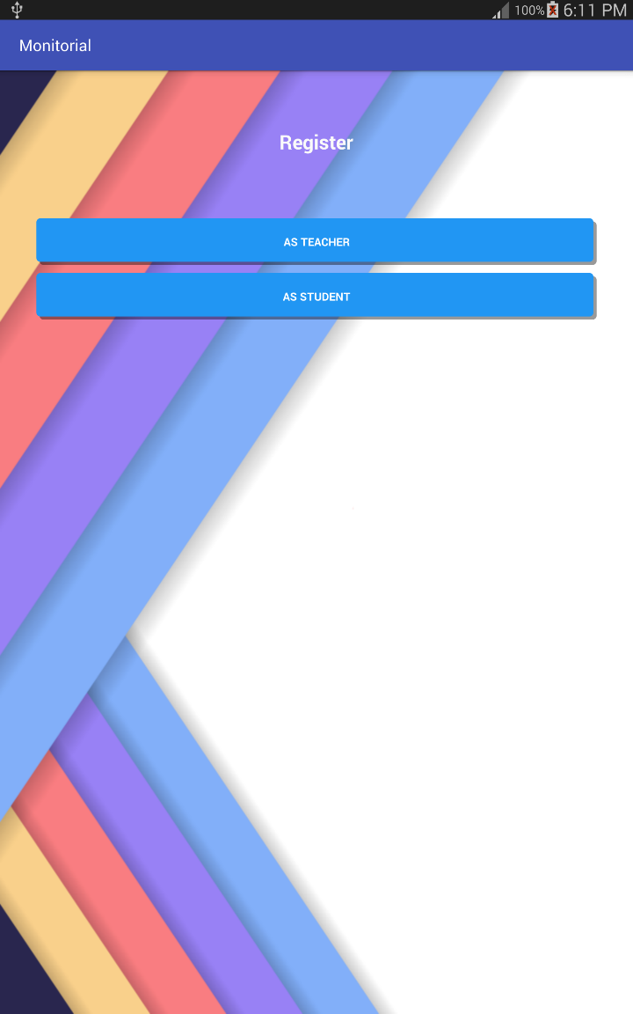
Project Structure
● When we first open our app we have two buttons.
One for Students and one for Teacher
● After clicking button as students or teacher we have the
The following layout

Slide 6
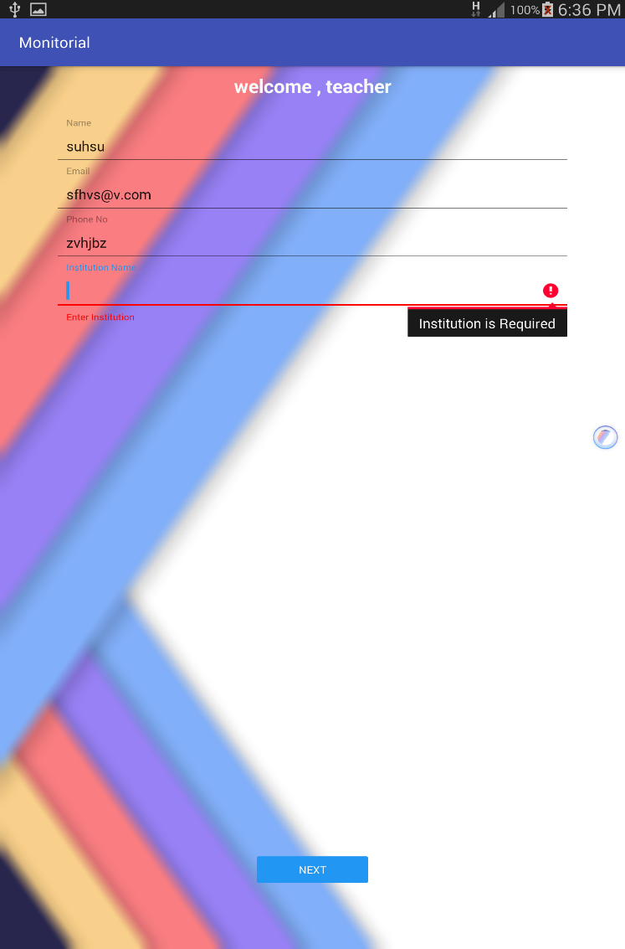
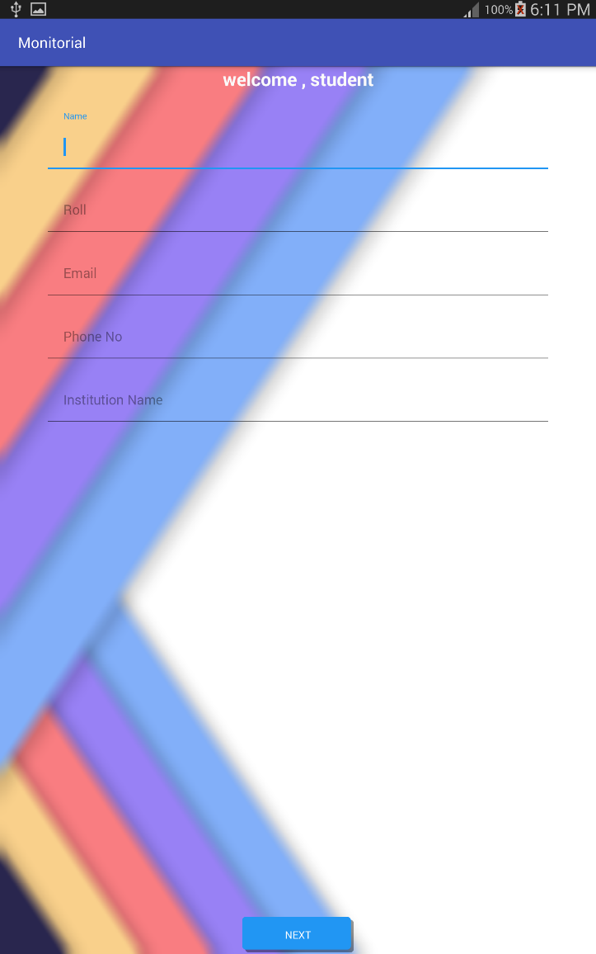
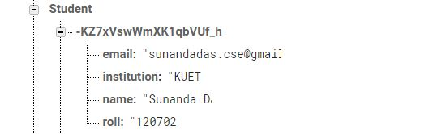
Project Structure
● We have two different layout for student and teacher.
● After register as student or teacher go navigation activity and data will be pushed in backend firebase

Slide 7
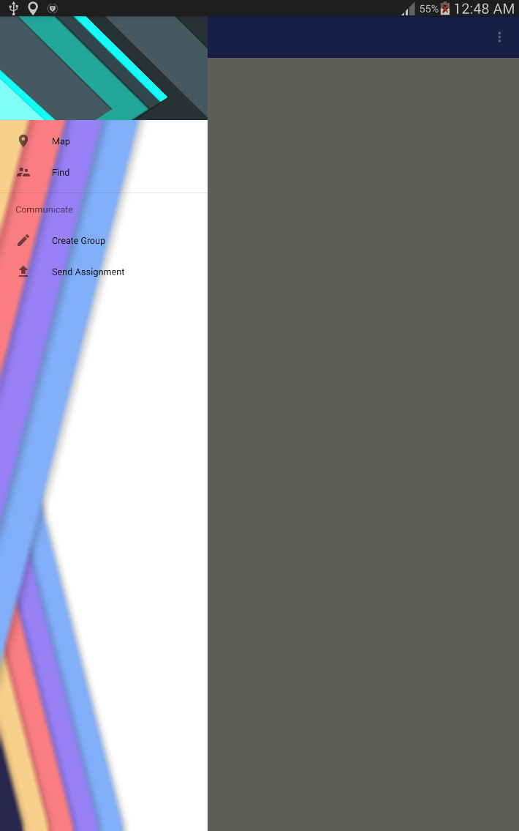

Project Structure
We have two different navigation activity one for student and one for teacher.
Navigation activity item has two section map section and communicate section
● Communicate section has create group , join group, Send Assignment and find assignment

Slide 8
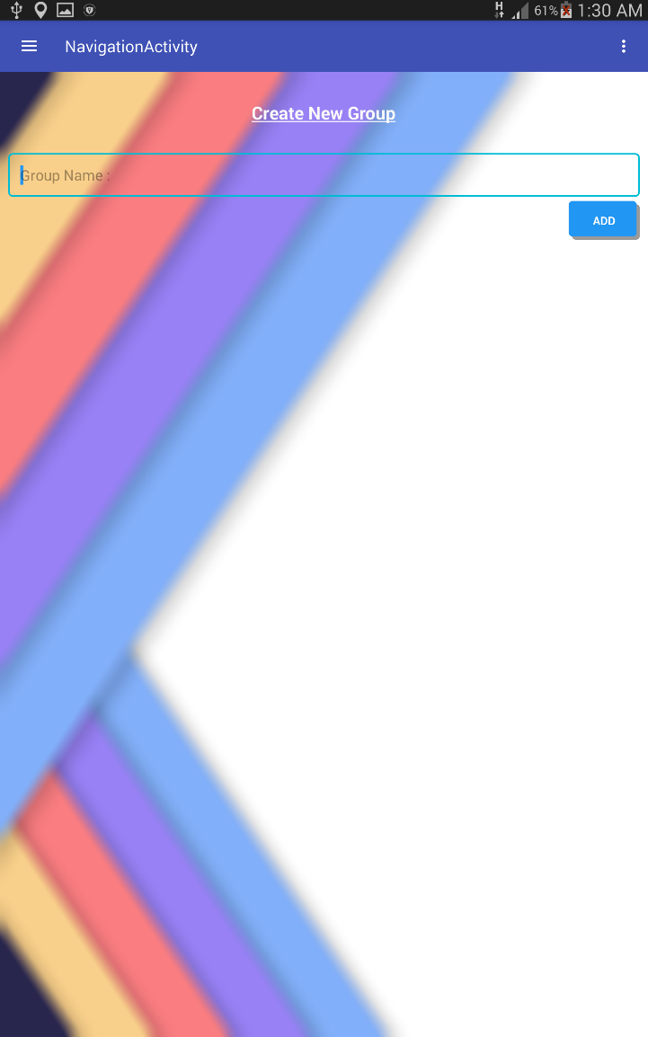
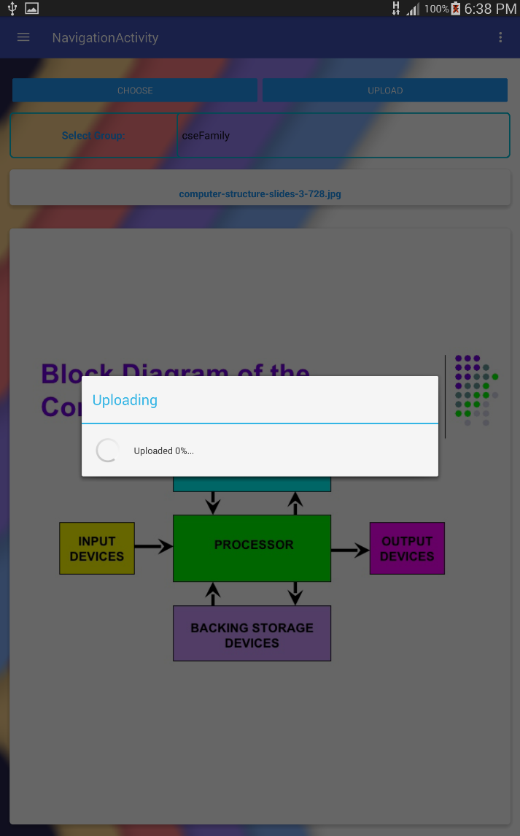
Project Structure
● Teacher can create as many group as he wants.
● After creating group he can send assignment and other resource to any Specific group .
● And the students connected to that group find the resource and can download it.

Slide 9
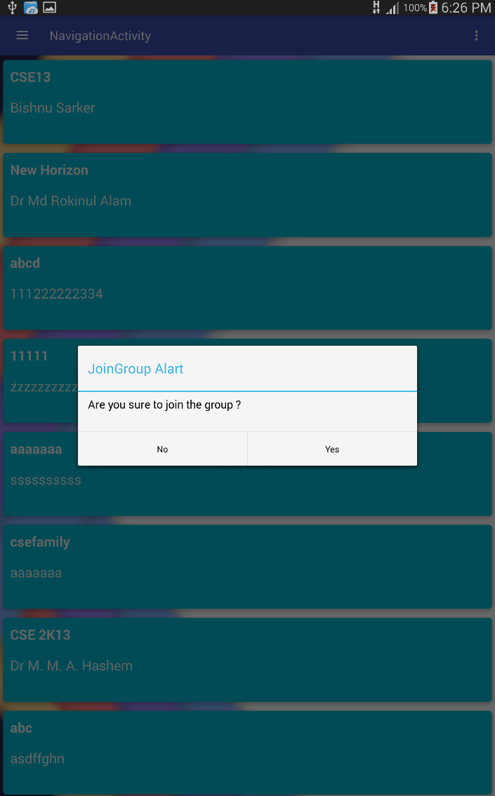
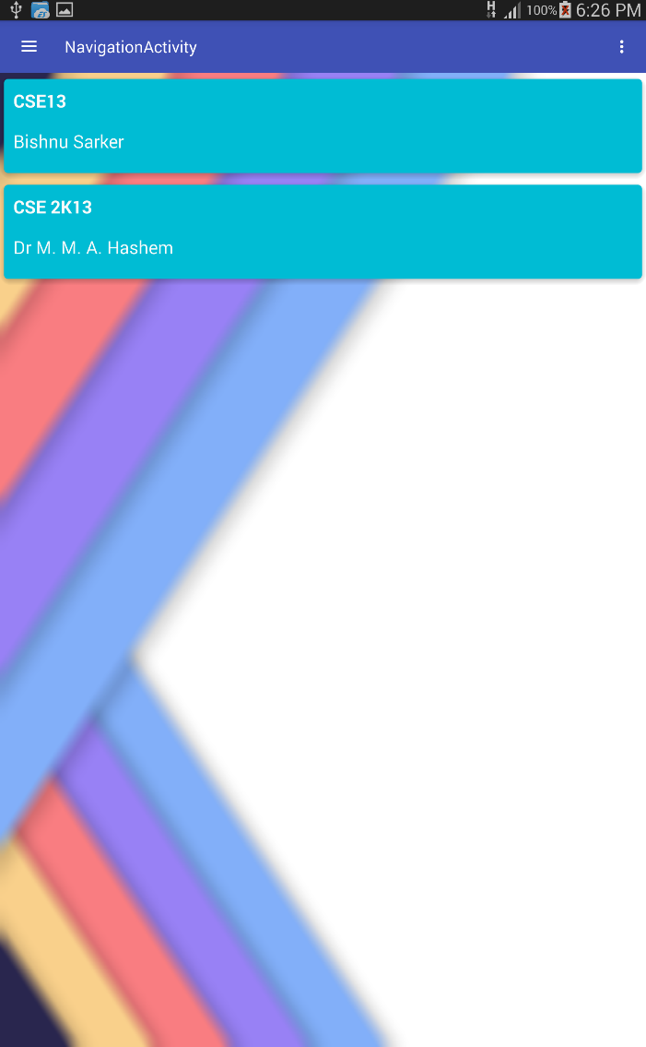
Project Structure
So students can also join many groups .and the their project resource dynamically
And if they want they can download the resource.
So we can say there is no delay between sending the resource and getting it.

Slide 10
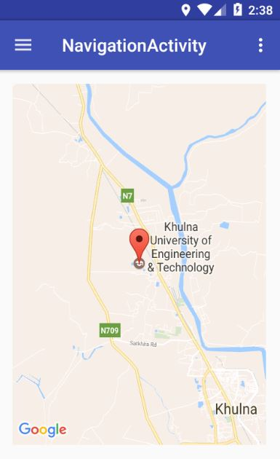
Feature and usefulness
Map
GPS and animated to current location
Here current location is pushing into firebase database and it’s doing in background as a background services.
From here the location will update to firebase database

Slide 11
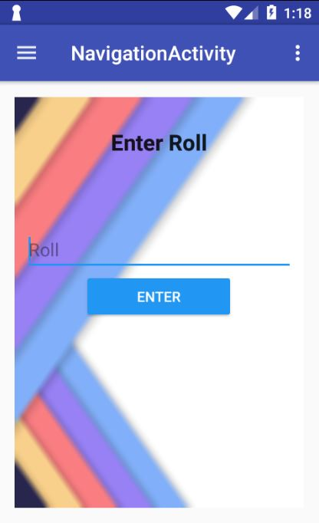
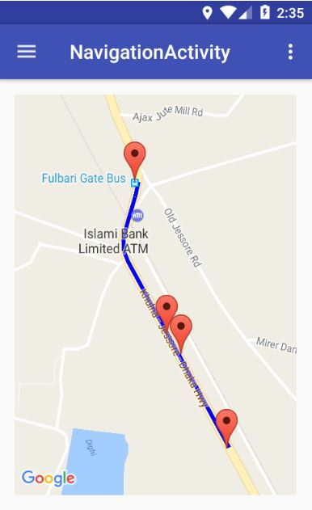
Feature and usefulness
In case of teacher, how wants to follow his student. Just put the roll number who are using the application and sign with the roll the student used.
In this activity, Location is getting from firebase.
Then the path on map will appear.

Slide 12
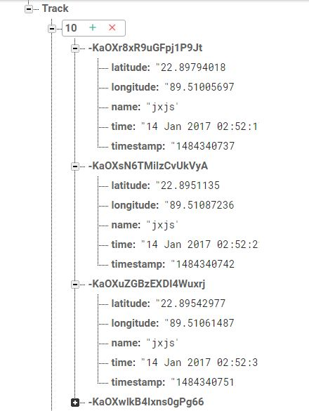
How current location is pushing as background service and getting values.
Student current location is pushing concurrently by getting the latitude and longitude values from GPS.
When authorizer search for one’s roll then latitude and longitude value takes from firebase and show the path

Slide 13
Limitations
As far as monitoring and supervision app implemented in a very short time, There is limitation.
Database design for huge data.
Unwanted exception may occur.
Location GPS is required for a device.
student need to input an unique roll to sign in otherwise there may override information.

Slide 14
Future planning and improvement
Developed through a good database design.
Enhancement for more user.
Enhancement for globally useable.
Project construction pattern.

Slide 15
Conclusion
It may be use as a community application between student and teacher. Here student can easily get assignment and teacher can send assignment at any time. So this could be an efficient application to monitor and supervise students.

